Slide 1
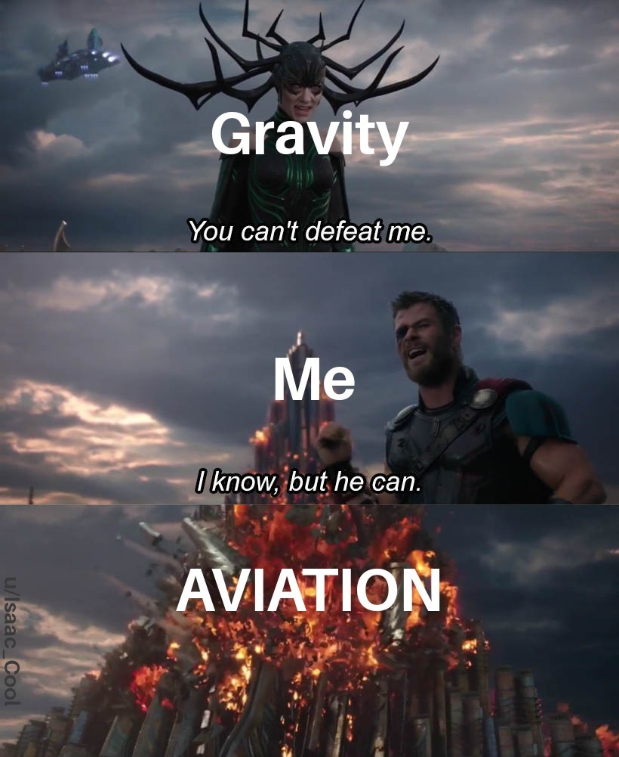
Basic Physics
2/20/21 Workshop
The one physics presentation where air resistance actually matters

Slide 2
Basics of Flight

Slide 3
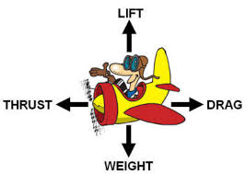
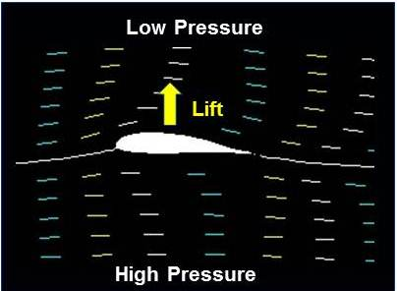
How do planes fly?
Air moving across the wings creates lift, which moves the plane up
The air moves faster across the top than the bottom of the wing, which makes pressure above decrease, and makes a force that lifts the wing(+ plane) ( this is called Bernoulli's Principle- in increase in velocity of a fluid results in a decrease of pressure)*technically this is only one possible explanation and none are yet scientifically valid
If the thrust from the propeller is greater than drag, the plane moves forward
If the lift generated is greater than the weight, the planes goes up/stays aloft

Slide 4
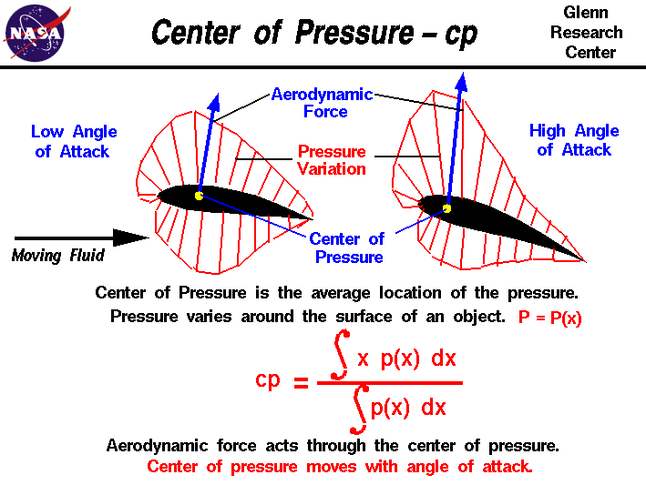
Center of Lift
Basically: Quarter Chord
A single vector of lift can be placed on ¼ of the way in from the chord - this is a way to summarize the lift generated by our wing at one point. We like to summarize distributed loads at a single point, it makes life a lot easier.
No, you do not need to know everything on the graphic to the right.

Slide 5
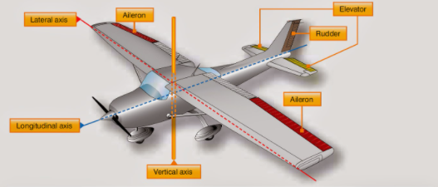
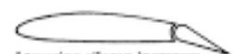
What are control systems and how do they work?
Control systems enable the pilot to control the movement of the aircraft, and the 3 systems in our aircraft are the:
Rudder: Allows for rotation around the vertical axis
Ailerons: Allows for rotation along the longitudinal axis
Elevators: Allows for rotation along the lateral axis
The rotation along these 3 axis gives the pilot control of the direction of the plane with yaw (rudder), roll ( aileron ), and pitch (Elevator). When a control system is slightly tilted to one side, a vacuum is created on the other side, pulling the aircraft.

Slide 6
Moment

Slide 7
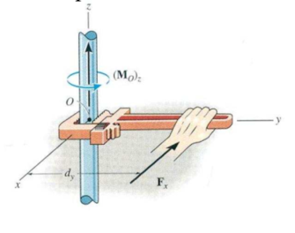
What is Moment?
A force * a distance makes a rotational moment.
Units: distance times force, ie (lbf*f, or pound feet)
Pound: lbf → unit for force in imperial
In FCA:
Center of Gravity
Small forces at large distance can HEAVILY affect the plane’s function
If you move your hand closer to the center it will be harder to spin the rod
Note:
Moment: rotational force that is resisted and will not cause the object to move
Torque: moment but it actually rotates

Slide 8
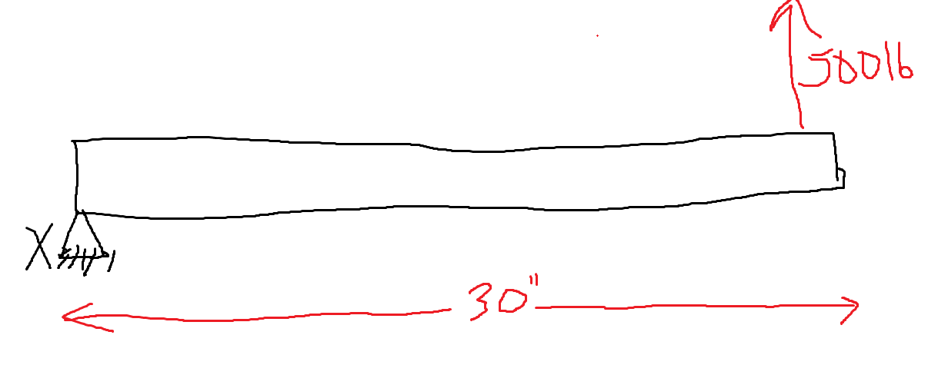
Quick! What is the moment around point x? (assuming the tube is static)
What direction will it turn? (if the tube is not static)
Mx = 15 klbin

Slide 9
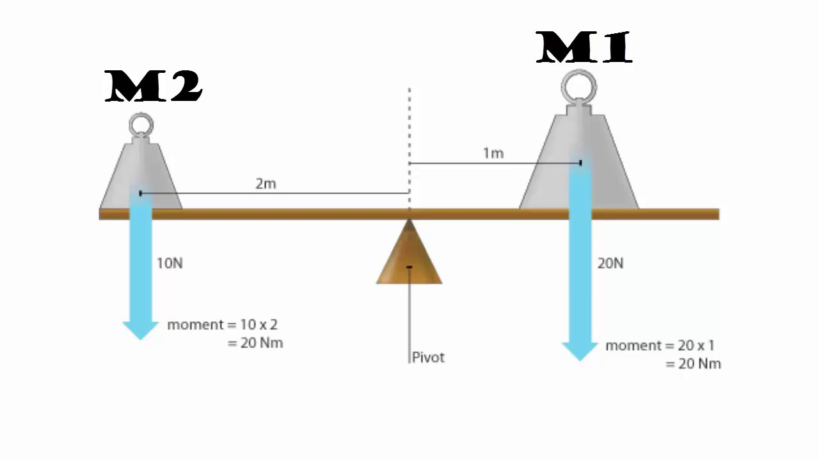
Center of Gravity
A balance of the moments
You take each individual weight and multiply it from a set center
In FCA: the center of gravity is where all our weight in front and behind are the same

Slide 10
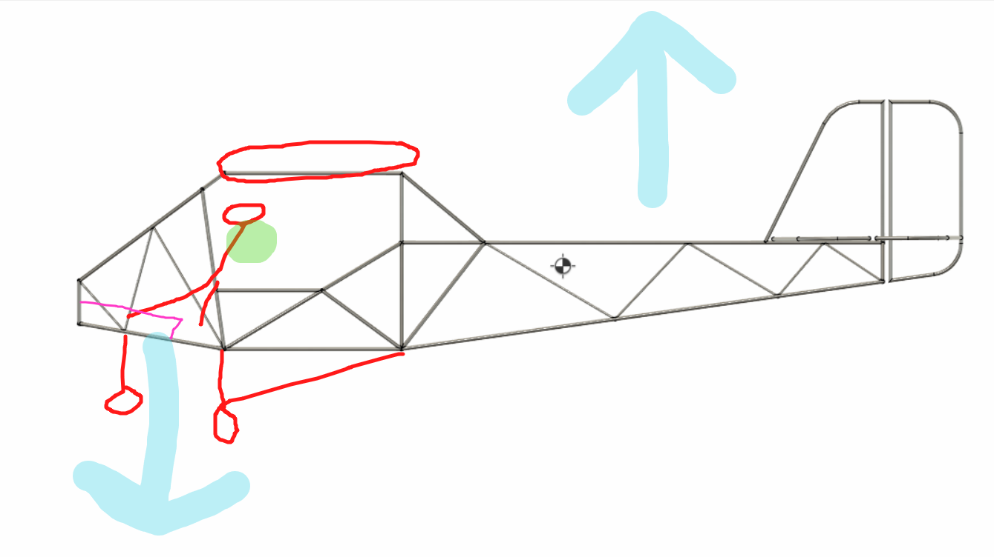
Weight is balanced on green point

Slide 11
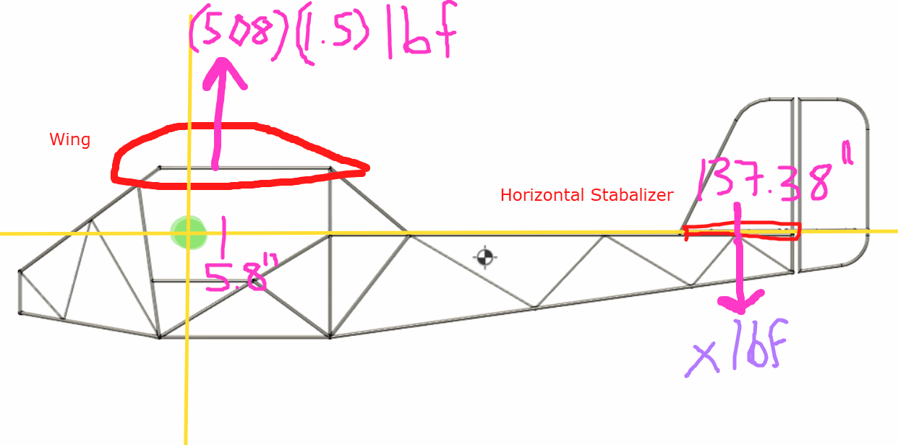
Lift vs Negative Lift
508: weight of plane
1.5: safety factor
5.8”: distance of QC to CG
127.38”: distance from HS center of lift to CG

Slide 12
Based on Knowledge of Moment, find x

Slide 13
Method:
*whiteboard share/ annotate

Slide 14
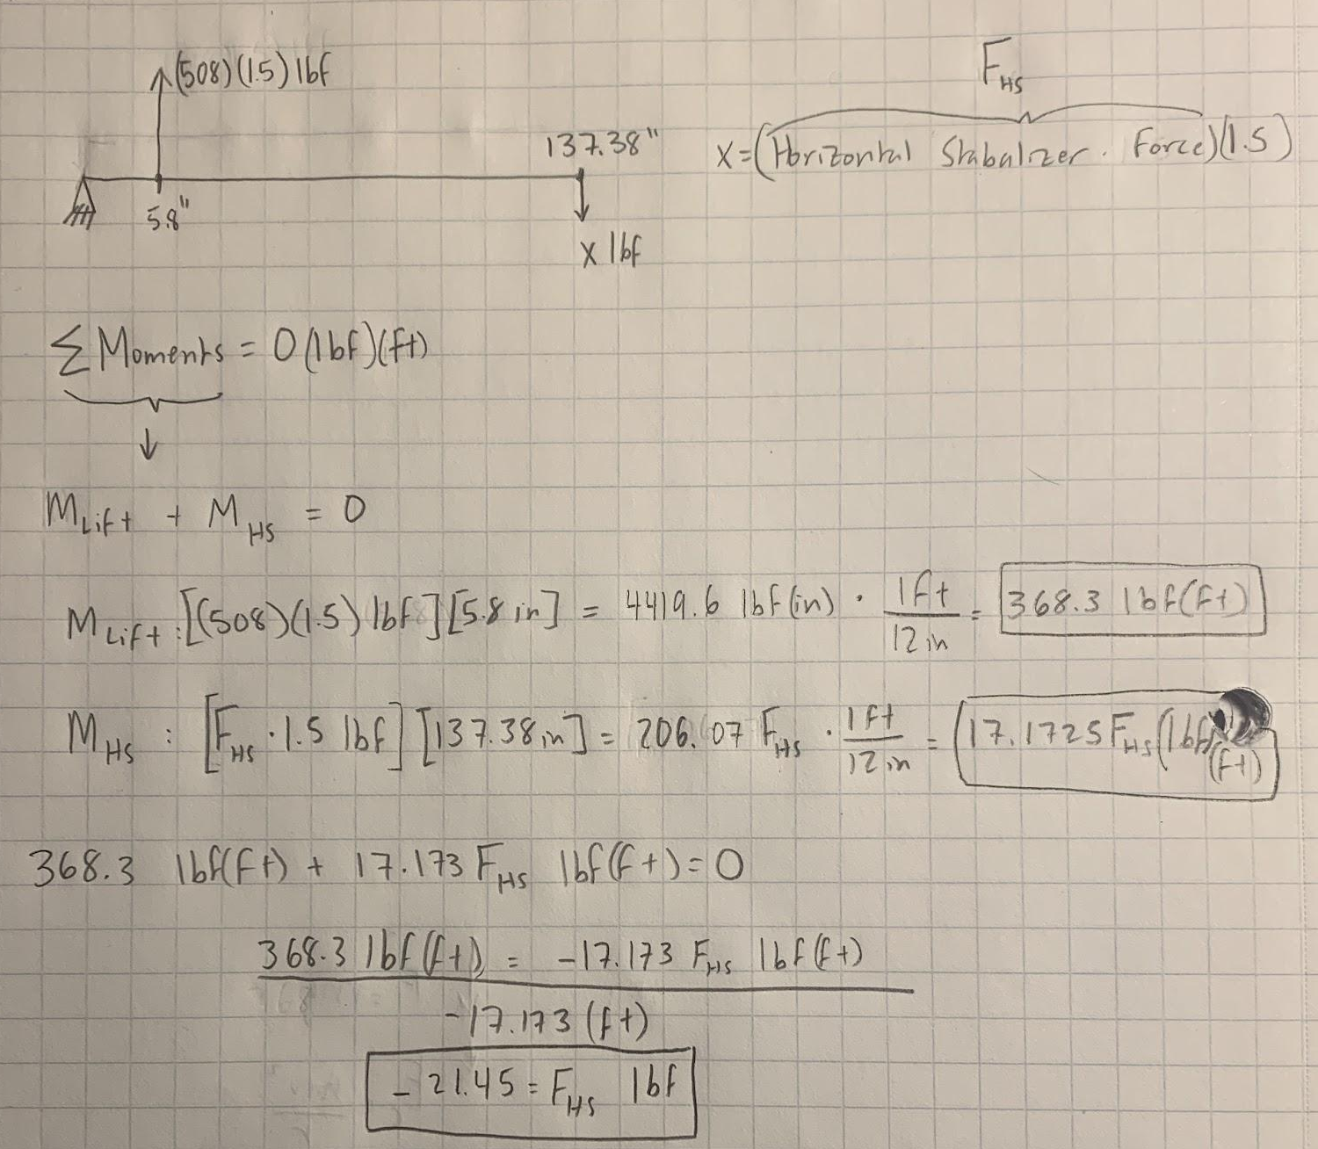
Method:
It makes sense that it is negative bc we established lift to be in the positive direction and this force is acting in the opposite direction
Notes:
Σ : sum (math, chem, physics symbol)
“Sigma”
lowercase (σ) means a different thing!!!
Variable (or type of bond hehe)
We use subscripts a lot
Please define them early so people know

Slide 15
Units

Slide 16
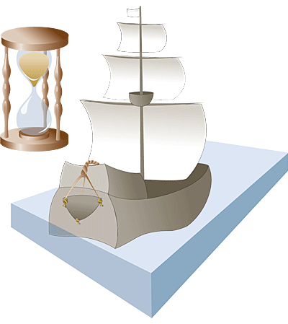
Knots
1 knot is 1 nautical mile per hour
1.15mph or 1.85km/hr
20.251969 inches per hour
Symbol = kn
1 nautical mile = 1.15 miles = 1.85 kilometers
1 nautical mile = 1 minute latitude
It comes from when sailors would use a rope with knots in it to approximate their boat’s speed

Slide 17
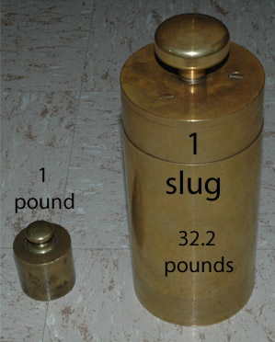
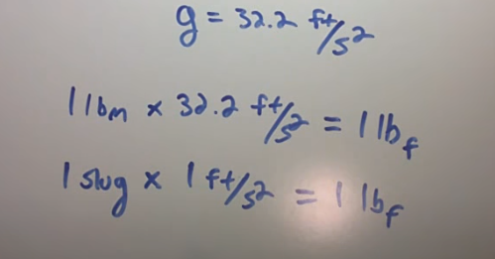
Slugs
A unit of mass, imperial
32.174lbs or 14.5939 kg
ft/s² → Feet per second squared is a unit of acceleration that shows change in velocity

Slide 18
g-force
*This is different that the g’s you may have worked with in physics class. It is not a the constant acceleration. When you see some force evaluated at 4 gs, that does mean 4*9.8m/s^2 but doesn’t actually use that number. Just multiply your forces by 4.
Gravitational force equivalent
Force per unit mass
1 g is acceleration due to earth’s gravity, 9.81 m/s²
(Max speed ÷ time to get to that speed) ÷ 9.81 m/s²

Slide 19
Pound Force vs Pound Mass vs Slugs
lbf = pound of force/pound-force → Unit of Force
Lbm= pound mass → Unit of Mass
Slug → Unit of Mass
Easier to convert from slugs (mass) to lbf (force) than from lbm (mass) to lbf

Slide 20
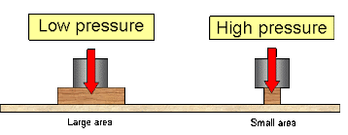
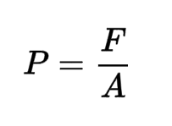
Pressure
Force distributed on an area
In FCA:
Psi : pounds per square inch
In material specifications
Higher : stronger
Atmospheres: pressure of air
Used in air viscosity: how resistant the liquid (gas) is to flowing
Higher: more resistant; think honey vs water → also density plays into this

Slide 21
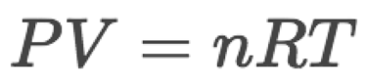
Chemistry Crash Course for Gases
You only low-medium need to know the specifics. Know the synthesis though
Ideal gas Law:
P: pressure (atm is the fav)
V: volume (usually L)
n: number of moles (amount of gas)
R: constant (0.082 if you use atm,L, moles, K)
T: temperature (Kelvin)
Synthesis:
In a gas: as temperature increases, so must pressure
If everything else stays constant

Slide 22
Converting Between Units
Sometimes certain softwares or calculations need data to be in terms of a specific unit, while you may have a measurement in another unit. If you’ve taken chemistry before, more courses cover Conversion Factors, which are ratios used to convert from one unit to another. For example, if you want to convert 3 km to meters, you’d use the conversion factor 1 meter/0.001km, and multiply the factor by the given number of 3 km:
3km * 1m/0.001km = (3km * 1m) / 0.001km = 3m/0.001 = 3000m

Slide 23
Practice:
Convert 36 knots to mph
Convert 3.2 Kilojoules to a Joule
Challenge: Convert 5 Slugs to lbf

Slide 24
Practice Solutions
36kt * 1mph/0.87kt = 41.43 mph
3.2kJ * 1J/0.001kJ = 3200J

Slide 25
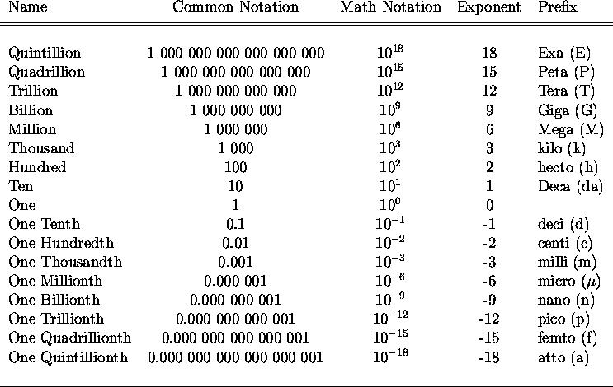
Side note
Kips = Kilo pound
Prefix kilo = 10^3 = 1000
1 kip = 1000 lbs

Slide 26
Fun Fun Calculation Time!
Here’s a problem Rudy had to calculate yesterday while doing math for the ailerons strength. Check out this link from the physics channel - https://dont-kill-ryan.slack.com/archives/CQL60UN74/p1613762101003800. Go to page 5 and find “maneuvering aileron loading” now use your resources (ie the onshape) to find the total lbf acting on one of our ailerons.

Slide 27
Fun calculation part two
We will now calculate the total moment around our aileron torque tube. (hopefully this will not be a torque - that would be bad). Remember the previous total lbf you calculate a moment ago. You will also need to remember the formula for moment arm calculations.
*Tip: lift distribution on an aileron is triangular, and the center (cg/cp) of a triangle will be at ⅓ height

Slide 28
Equations

Slide 29
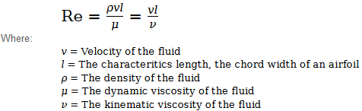
Reynolds Number
When designing a wing, the air around a mini model will act differently when the wing is made bigger, Reynolds Number helps to manage this change
Connected to air resistance and viscosity/compressibility of the air
Big Reynolds Number = low viscosity effect on plane → higher the better for us
When objects move through gas, some gas molecules stick to the surface of the object, creating a boundary layer
“The Reynolds number expresses the ratio of inertial (resistant to change or motion) forces to viscous (heavy and gluey) forces.”

Slide 30
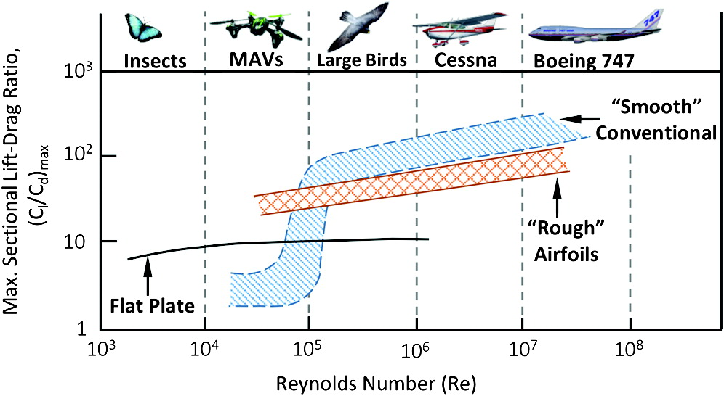

Slide 31
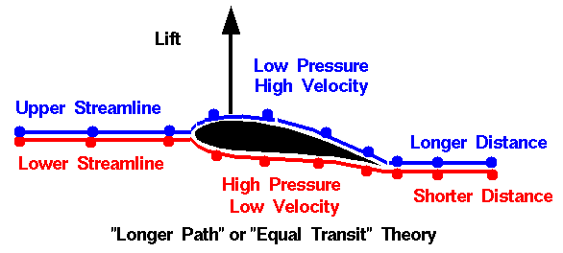
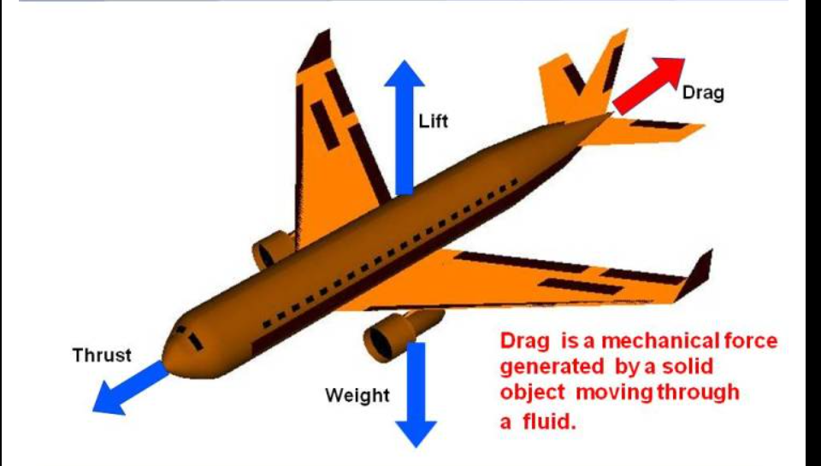
Lift And Drag
Lift: The aerodynamic force produced by an airfoil moving through a fluid. Lift is a vector quantity, meaning that it has a magnitude ( how strong the lift is ) and a direction ( in what the direction the lift is being applied )
Drag: A mechanical force produced by the contact between a solid body and a fluid.

Slide 32
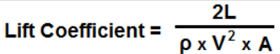
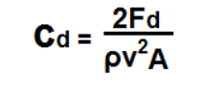
Lift and Drag Coefficients
A Coefficient: A way to quantify a property, such as lift, drag, friction, and many others
Lift Coefficient: relates the lift produced by a body to the surrounding fluid density and velocity, as well as the area of the body
L is Lift Force, A is projected area of the body in ft², ρ is the air density in slugs/ft³, V is the fluid velocity in ft/s.
Drag Coefficient: Used to quantify the drag on a body
*there are equations/graphs to calculate these coefficients. Similarly, there are equations/graphs to turn them into actual useable numbers
F_{d} is drag force, p is fluid density, v is velocity of the body, and A is the reference area ( surface area of the body where drag is induced)

Slide 33
Practice
Find the lift Coefficient!
Velocity = 46 knots
Lift = 503 lb
Density of air = 0.0659 lb/ft^3
Wing Length: 32 ft
Chord: 6ft

Slide 34
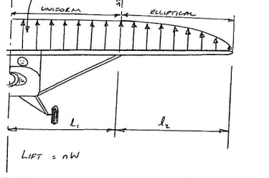
Schrenk Approximation
Wings breaking off due to not being strong enough to withstand lift forces is something you really don’t want to happen, which is why great attention is given to the spanwise lift distribution. We want our aircraft to have an elliptical lift distribution:
We can plot the Schrenk Approximation using some big brain mathematics

Slide 35
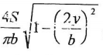
Step 1: Create a quarter ellipse with its width being half the span of the wing, and the height being , where S is wing area, b is wing span, and y is the distance
from the aircraft centerline, and graph this for the values of y along with the chord ( distance from leading to trailing edge ) at that value of y, and draw a line that represent the average of these 2 graphs . This average line represents c*Cl , where c is the chord at a point and Cl is the lift coefficient at that point, and you get the graph of the Schrenk Approximation.

Slide 36
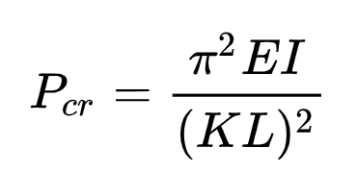
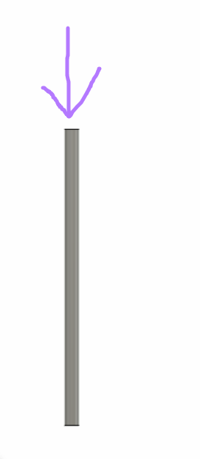
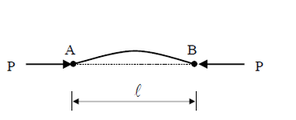
Euler’s Column Buckling
What is the maximum load on a beam face on
E: modulus of elasticity
You can find this on any materials info sheet
I : Area Moment of Inertia (cross section)
K: a constant depending on beam constraint (2 slides later)
L: unsupported length of the beam

Slide 37
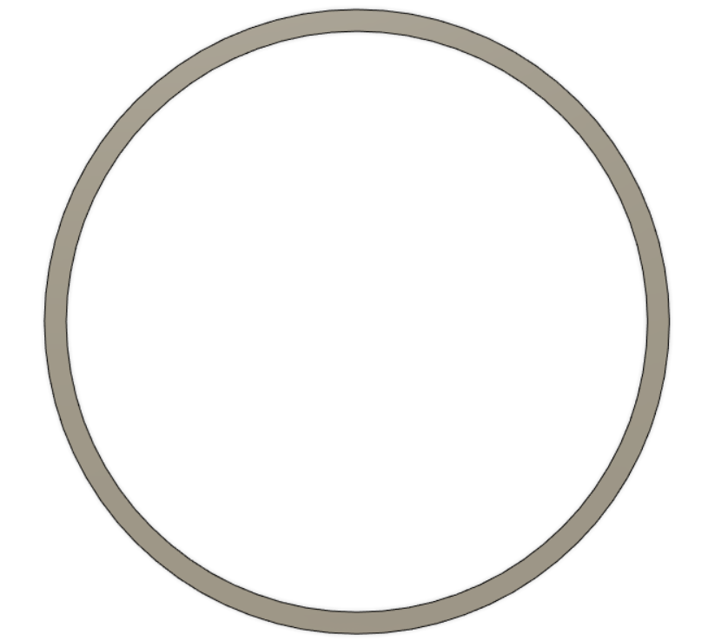
Area Moment of Inertia
Depends on shape!
Just use an online calculator for basic shapes (tubes, squares, etc)
https://skyciv.com/free-moment-of-inertia-calculator/
For more complicated shapes like our aerodynamic tubing, use CFD

Slide 38
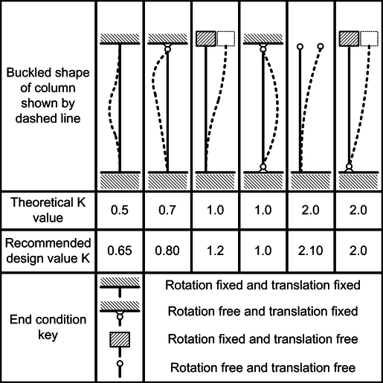
K Values
Dashed : fixed

Slide 39
Activity Instructions
Make a copy of slide 40 and edit the translation/ rotation dispositions to match your assignment
Fill in the parts in green of the chart as independent variables
Calculate the area moment of inertia (cross section area)
Determine your K value
Find the maximum column buckling strength of the beam
Draw a diagram of the forces on the beam + how its fixed
Attach it to the slide

Slide 40
Yay now do your own equations!
Translation | Rotation | Name (s)
Fixed - Fixed | Fixed - Fixed | Jasmine
Fixed - Fixed | Fixed - Free | Kyle
Fixed - Free | Fixed - Fixed | Agastya
Fixed - Fixed | Free - Free
Fixed - Free | Fixed - Free
Fixed - Free | Free - Fixed

Slide 41
Fixed - Fixed || Fixed - Fixed
Situation: (ex. Tubing with OD 1”, wall: 0.035)
Assignment:
Choose what type of attachment you want → options are on the previous slide
Make a pipe (any dimensions you want) in fusion → take the cross sectional area & plug it into the “area moment of inertia column”
Based off the type of attachment - plug in K value
Solve for max column buckling force
Red: independent
Yellow: dependant
Length | Material | Modulus of Elasticity - found off Mattweb | Area moment of inertia | K value | Max Column Buckling Force
2 ft | 4130 Chromoly Steel |  | 12.57 | (either 1.2 or 1)
Notes:
Jasmine

Slide 42
Fixed - Fixed || Fixed - Free
Situation: (ex. Tubing with OD 1”, wall: 0.035)
Assignment:
Choose what type of attachment you want → options are on the previous slide
Make a pipe (any dimensions you want) in fusion → take the cross sectional area & plug it into the “area moment of inertia column”
Based off the type of attachment - plug in K value
Solve for max column buckling force
Red: independent
Yellow: dependant
Length | Material | Modulus of Elasticity - found off Mattweb | Area moment of inertia | K value | Max Column Buckling Force
5 feet | 4130 Chromoly Steel |  |  | 0.8

Slide 43
Fixed - Free || Fixed - Fixed
Situation: (ex. Tubing with OD 1”, wall: 0.035)
Assignment:
Choose what type of attachment you want → options are on the previous slide
Make a pipe (any dimensions you want) in fusion → take the cross sectional area & plug it into the “area moment of inertia column”
Based off the type of attachment - plug in K value
Solve for max column buckling force
Red: independent
Yellow: dependant
Length | Material | Modulus of Elasticity - found off Mattweb | Area moment of inertia | K value | Max Column Buckling Force
2 feet | 4130 Chromoly Steel | 2900 KSI | 164.221 | 0.5 | 476240.9

Slide 44
Clark Y behaviors
http://airfoiltools.com/airfoil/details?airfoil=clarky-il

